Slide 1
EC513 Presentation
Yixing Yao, Animisha, Arthur Hua, Ronghao Ye

Slide 2
Introduction
We observed that although many blocks sit at the LRU end, they’ve actually been accessed multiple times. Conversely, some blocks that were inserted more recently have only been accessed once or twice.
We also observed that in some cases blocks have different importance according to load/store. So add a tax due to the prediction of load/store for each block may also increase the performance.
Notes:
“Let’s walk through the key difference between a classic LRU policy and what we’ve implemented.
Lets see How LRU works first
Under a traditional LRU replacement, each cache line carries a timestamp or counter that tracks exactly when it was last accessed—either on insertion or on any hit. When the cache needs to evict a line, it simply scans for the line with the oldest timestamp, the one that hasn’t been touched for the longest time. It’s a precise, recency-based decision: “whoever was used least recently goes first.”
so How our policy works？
In our project, we replace that full timestamp with a much simpler VisitCount counter on each line. • When a line is filled (on a miss), we initialize VisitCount = 1.
• On every subsequent hit to that line, we just add one to visitcount
We then rank the lines in the set by their raw access frequency instead of last-touch time. When it’s time to evict, we collect the group of lines with the smallest VisitCount—the coldest ones—and we don’t simply evict the absolute lowest. Instead, we pick the median of that coldest group because we dont want to go through the whole set, which increases complexity

Slide 3
Original Plan
Final Algorithm
Implementing PSLRU which is a weighted LRU with visit count and load store prediction
Load misses are more costly than store misses
Gives each block a score based on visitCount, last tick touched and if it is a load store.
A replacement policy that sorts the least visited blocks and picks the middle touched block to be replaced
Idea was to flatten the difference in performance between most recently touched and least recently touched to provide a more consistent performance on certain benchmarks.

Slide 4
Difference
LRU: Mark each block with a last touch time when the block is setted or touched. When selecting which one should be replaced, always choose the one with lowest last touch time.
Our project: Mark each block with its VisitCount number. Set it as 1 when it is setted. Add 1 when it is touched. During selection, find blocks with least number of VisitCount, and just choose the one in the middle among those blocks, which just have one iteration.
Notes:
“Let’s walk through the key difference between a classic LRU policy and what we’ve implemented.
Under a traditional LRU replacement, each cache line carries a timestamp or counter that tracks exactly when it was last accessed—either on insertion or on any hit. When the cache needs to evict a line, it simply scans for the line with the oldest timestamp, the one that hasn’t been touched for the longest time. It’s a precise, recency-based decision: “whoever was used least recently goes first.”
so How our policy works？
In our project, we replace that full timestamp with a much simpler VisitCount counter on each line. • When a line is filled (on a miss), we initialize VisitCount = 1.
• On every subsequent hit to that line, we just add one to visitcount
We then rank the lines in the set by their raw access frequency instead of last-touch time. When it’s time to evict, we collect the group of lines with the smallest VisitCount—the coldest ones—and we don’t simply evict the absolute lowest. Instead, we pick the median of that coldest group because we dont want to go through the whole set, which increases complexity

Slide 5
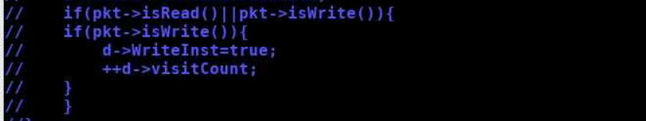
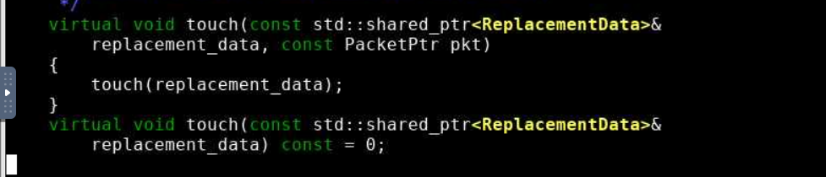
Challenges
Predicting load store which would assign a weighted score depending on the instruction type
Tried to use the Packetptr pkt to use the functions pkt.isRead() and pkt.isWrite() to add weight
However overriding the original touch function to include the pkt pointer was a challenge

Slide 6
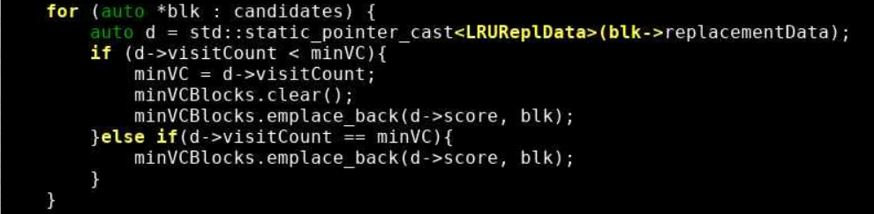
Working for our Replacement Policy
Instead of using read and write we sorted the least visited blocks and chose the median touched
Our replacement policy is like a hybrid of LRU and LFU policies
Ideally we would have chosen a victim based on most recently touched along with a weighted score
Notes:
How Our Policy Works (vs. Classic LRU)
Design Motivation We observed that pure LRU evicts the single least-recently-used line every time—even if that line has very few past accesses. By instead targeting a “median” hotness value, we strike a balance between discarding truly cold data and preserving moderately reused blocks.
Key Data Structure Each cache line keeps a simple visitCount (incremented on every touch), rather than a full LRU stack position.
On Every Cache Access (“touch”):
Increment the line’s visitCount.
Don’t reorder any other entries—this remains O(1).
On a Cache Miss (“replacement”):
Collect all ways in the set along with their current visitCount.
Sort or select the subset of lowest-visitCount lines (e.g. bottom 3) by count.
Within that coldest group, pick the median visitCount line (instead of the absolute minimum) to evict.
Why Median, Not Min or Max?
Min: might still be a line that’s just temporarily cold but about to be used again
Max: would keep cold data too long, defeating the purpose
Median: removes truly underutilized lines while avoiding thrashing of lines with marginal reuse
Benefits Over LRU
Lower metadata overhead: just a counter per line, no full recency stack
Adaptive hotness filtering: coldest-yet-not-extremely-cold lines are preserved
Better hit rates on workloads with uneven reuse patterns, as seen in our 5–15% miss-rate improvements

Slide 7
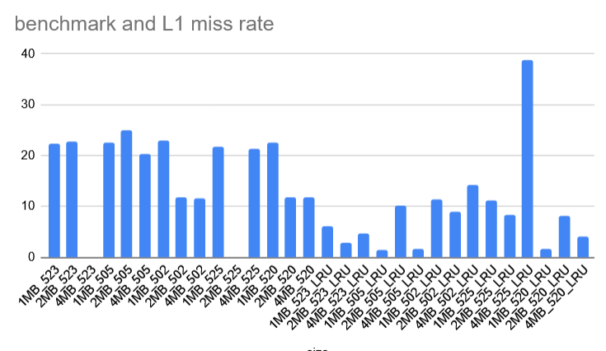
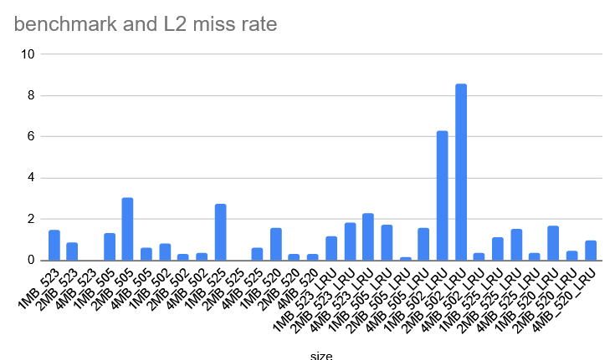
Results Comparison

Slide 8
If we can start over
Trying to use real LRU policy for selecting among the blocks with lowest Visitcount
Trying to find how to transmit the packet port to replacement policy which might require rewriting the base class
Use two link list instead of loop to protect hot blocks and cold blocks separately in sequence of LRU.

Slide 9
Suggestions
https://doxygen.gem5.org/release/current/index.html This page is really helpful for finding where classes are defined
Start early since the huge cost of time for simulation

Slide 10
References
https://jilp.org/vol10/v10paper8.pdf
https://celerdata.com/glossary/what-is-the-slru-algorithm-and-why-does-it-matter

